Slide 1

PRELIMINARY STUDY OF LITHOLOGY CLASSIFICATION USING CNN AUTOMATION PRINCIPLE, POSEIDON GAS FIELD CASE
JEREMY ADI PADMA NAGARA
101116015
GEOPHYSICAL ENGINEERING
UNIVERSITAS PERTAMINA, INDONESIA

Slide 2

Outline
INTRODUCTION
BACKGROUND
SUBJECT LIMITATION
OBJECTIVES
WORK FLOW
LITERATURE REVIEW
REGIONAL GEOLOGY
WELL LOG
CNN
DATA AND METHOD
RESULT
CONCLUSION

Slide 3
Introduction
BACKGROUND
LITHOLOGY CLASSIFICATION
CONVOLUTIONAL NEURAL NETWORK
PETROPHYSICS
MACHINE LEARNING
ANALYSIS OF COMBINATION OF VALUE OF VARIOUS LOGS FOR LITHOLOGY DETERMINATION
TIME CONSUMING
UTILIZING AUTOMATION PRINCIPLE FOR LITHOLOGY CLASSIFICATION
SHORTEN THE WORKING TIME
DEEP LEARNING USED FOR IMAGE CLASSIFICATION IN COMMON BECAUSE ITS ABILITY TO PROCESS BIG-SIZE INPUT EFFECTIVELY

Slide 4
Introduction
PROCESS
THE PROCESSING PHASE WILL UTILIZE PYTHON PROGRAMMING LANGUAGE AS ITS MAIN TOOL
DATA
SUBJECT
LIMITATION
THE DATA USED FOR THIS RESEARCH ARE WELL-LOGS FROM 3 WELLS, NAMELY GAMMA RAY LOG (GR), DENSITY LOG (RHOB), AND POROSITY LOG (NPHI)
TARGET
THE RESEARCH WILL BE LIMITED TO LITHOLOGY CLASSIFICATION OF POSEIDON 2 WELL

Slide 5
Introduction
UNDERSTANDING VARIABLES THAT WILL OPTIMIZE CNN MODEL
2
OBJECTIVE
OBJECTIVE
OBJECTIVE
1
3
LITHOLOGY PREDICTION IN POSEIDON 2 WELL USING CNN
THIN LAYER EFFECT ANALYSIS

Slide 6
Introduction
WORK FLOW
STEP 4
4
CALCULATING THE ACCURACY OF PREDICTION
STEP 3
MODEL TESTING (LITHOLOGY PREDICTION POSEIDON 2)
3
STEP 2
2
BUILDING CNN MODEL
1
STEP 1
DATA PREPARATION

Slide 7
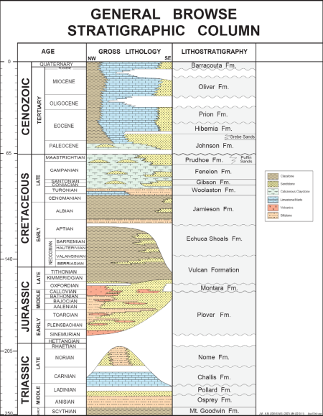
RESEACRH STARTING POINT (4086 m)
Main Target :
PLOVER FORMATION
RESEARCH END POINT (5297 m)

Slide 8
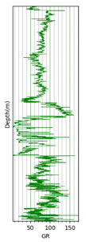

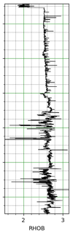

Literature Review
WELL LOG
GR LOG
NPHI LOG
RHOB LOG
Used for calculating the Shale content of Formation
Used for calculating the porosity of Formation
Used for calculating the denity of Formation
FORMULA :
PHIN =
(PHIe * Sxo * PHINw) + (PHIe * (1-Sxo) * PHINh) + (Vsh * PHINsh) + ((1-Vsh-PHIe) * Sum(Vi * PHINi)
FORMULA :
GR API =
8 x U Conc. +
4 x Th Conc. +
16 x K Conc.
FORMULA :
$$ρ_{e = 2ρbulk \frac{Z}{A} }$$
Source : Crain’s Petrophysical Handbook

Slide 9
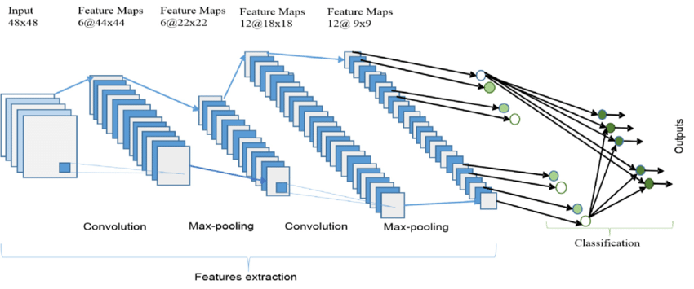
Literature Review
Convolutional Neural Network (CNN)

Slide 10
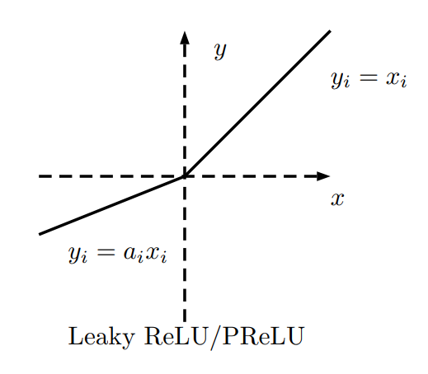
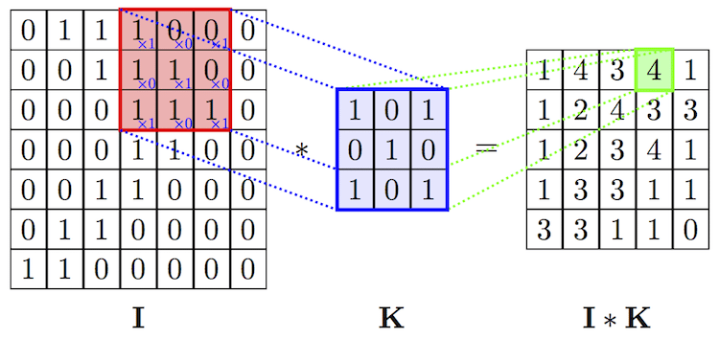

ACTIVATION FUNC.
20 | -1 | 1 | 3
13.4 | 8 | 5 | 4
15 | -14 | -3 | 5
-14 | 1 | 1 | 6
20 | -0.1 | 1 | 3
13.4 | 8 | 5 | 4
15 | -1.4 | -0.3 | 5
-1.4 | 1 | 1 | 6
$$α=0.1$$
The function that determines whether or not a neuron is active depends on its relationship to output. Very helpful model in studying non-linear data
CONVOLUTION
MAX POOLING
20 | 0 | 1 | 3
13.4 | 8 | 5 | 4
15 | 0 | 0 | 5
0 | 1 | 1 | 6
20 | 3
13.4 | 5
15 | 5
1 | 6
CNN
Multiplication of Dot Product Matrix between Kernel Matrix (Red Box) in matrix I with a filter Matrix K
Taking the largest number from a predetermined group (Pooling)

Slide 11


Data and Method
SOFTWARE
DIGITATION
GetData Graph Digitizer
To digitize the lithology interpretation image and translate it into text.
CNN
Python
Used to build CNN models, train the model, test the model and plot the results

Slide 12
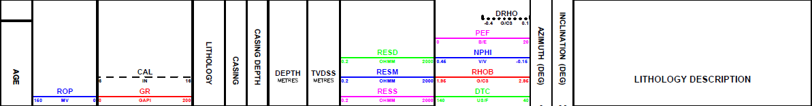
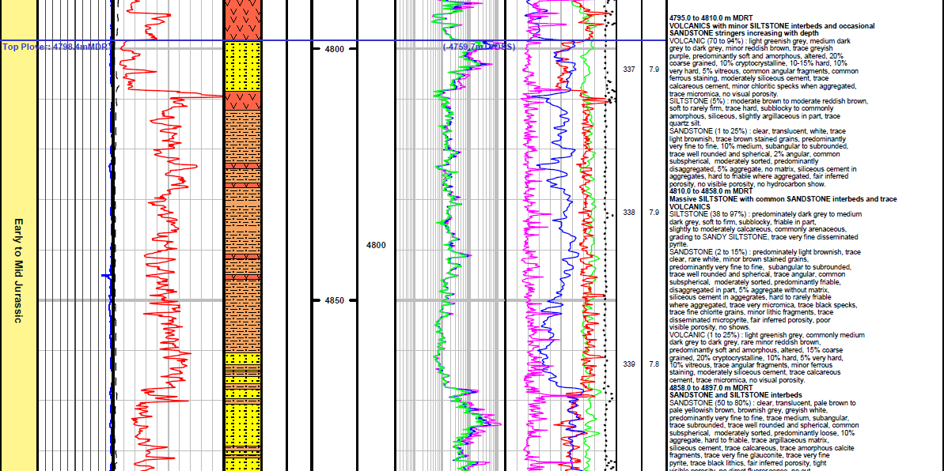
Data and Method
INTERPRETED WELL LOG
Data Well-Log ConocoPhillips Interpretation (Browse Basin) Pty Ltd → PDF Format
The Log Used for this Research:
Gamma Ray Log
Density Log Neutron Porosity Log
1
2

Slide 13
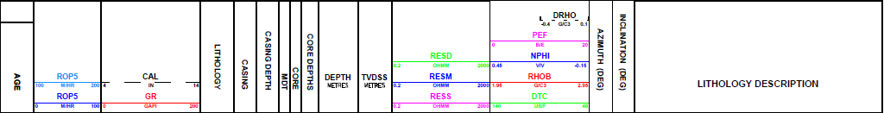
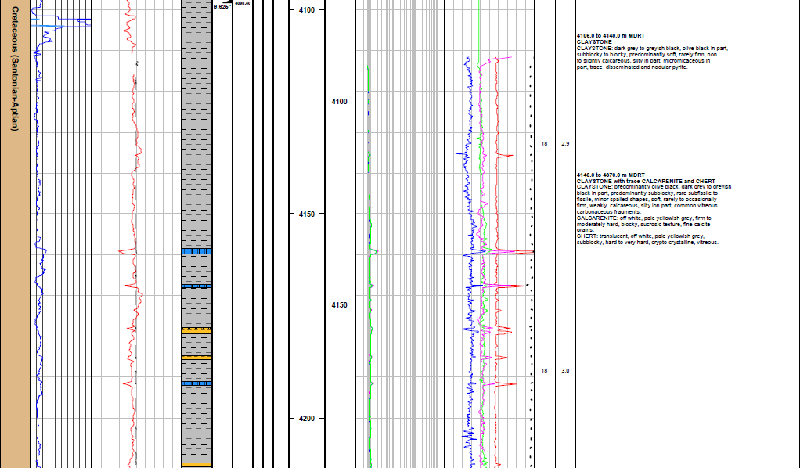
Data and Method
INTERPRETED WELL LOG
TRAINING DATA : POSEIDON 1
TEST DATA : POSEIDON 2

Slide 14
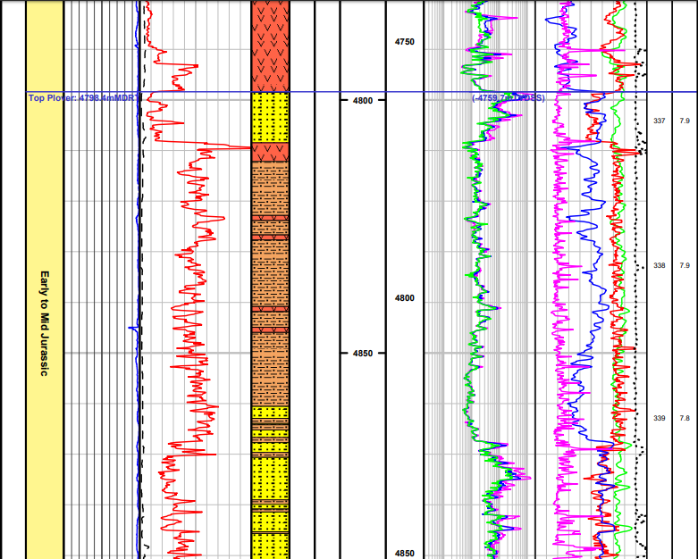
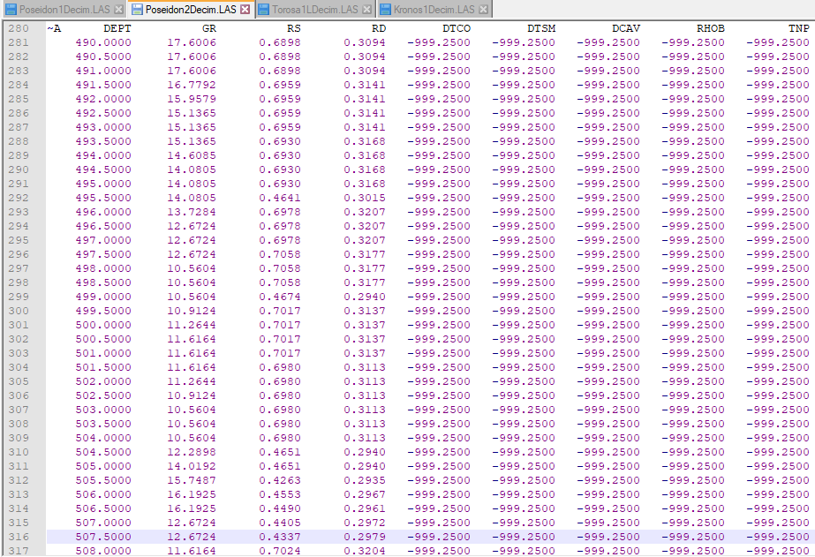
Data and Method
DIGITATION AND DATA CONCATENATING
+
 | Min | Max
Depth | 3887 m | 5104.5 m
GR | 7.136 API | 198.63 API
RHOB | 1.44 g/cm3 | 3.03 g/cm3
NPHI | 1.04 | 50.19
Lithoogy (after simplification) | Calcilutite Claystone Sandstone Siltstone Volcanic
 | Min | Max
Depth | 4086 m | 5297 m
GR | 5.37 API | 171.26 API
RHOB | 1.52 g/cm3 | 3.15 g/cm3
NPHI | 3.69 | 70.17
Lithology (after simplification) | Calcarenite Calcilutite Chert Claystone Sandstone Siltstone Volcanic
=
TRAINING DATA : POSEIDON 1
TEST DATA : POSEIDON 2

Slide 15
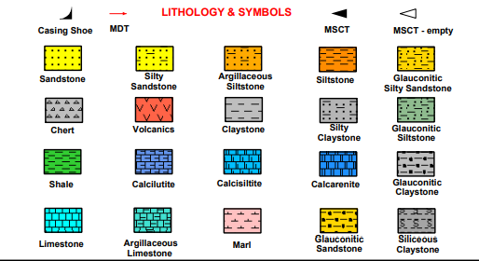
Data and Method
LITHOLOGY SIMPLIFICATION
BEFORE
AFTER
Text (Fasies) | Code
Argillaceous Siltstone | 0
Calcarenite | 1
Calcilutite | 2
Claystone | 3
Limestone | 4
Sandstone | 5
Siltstone | 6
Silty Claystone | 7
Silty Sandstone | 8
Volcanics | 9
Text (Fasies) | Code
Calcarenite | 0
Calcilutite | 1
Chert | 2
Claystone | 3
Limestone | 4
Sandstone | 5
Siltstone | 6
CONOCOPHILLIPS INTERPRETATION
20 Lithology (490 – 5351 meter)
Research Focus 1. Poseidon 1 (3887 – 5104.5 meter) : 7 Lithology 2. Poseidon 2 (4086 – 5297 meter) : 7 Lithology

Slide 16
Data and Method
DATA PREPARATION
DATASET SEPARATION
LITH.
SIMPLIFICATION
DATASET SCALING
LABEL ENCODING
Dataset containing 3 types of well-log and Lithology is separated.
Dataset : Data Well- Log
Label : Lithology Target
Pandas Module is used
Classify complex lithology to the parent lithology
Dataset Standardization, mean = 0, Standard Deviation = 1
Sklearn Module is used
Converting lithology code to One Hot Vector
Sklearn Module is used

Slide 17
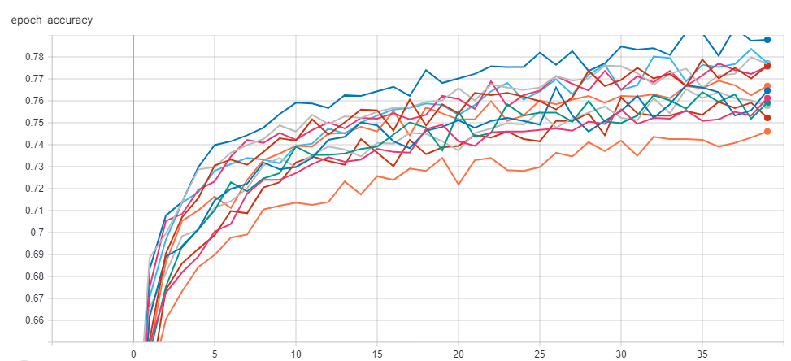
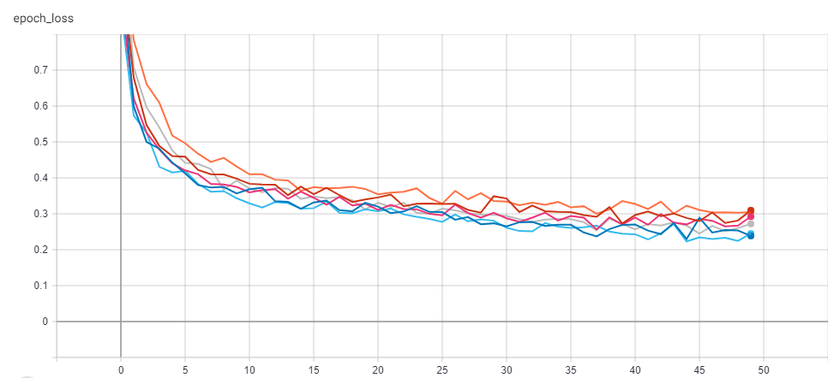
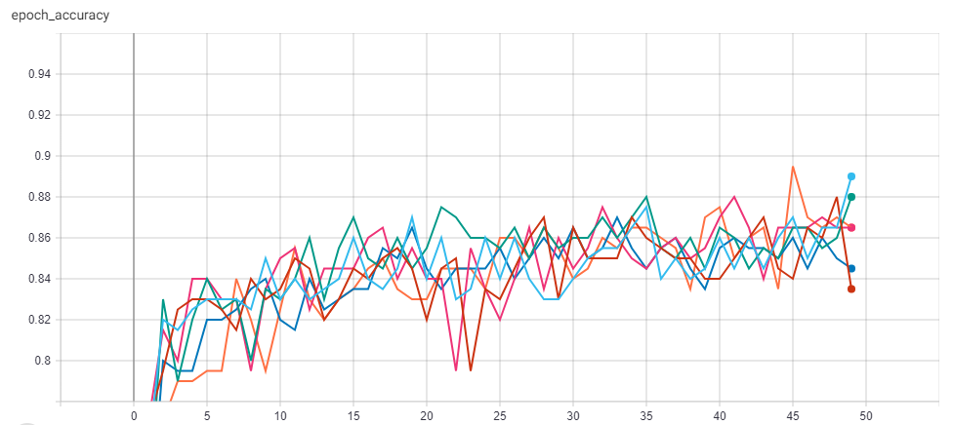
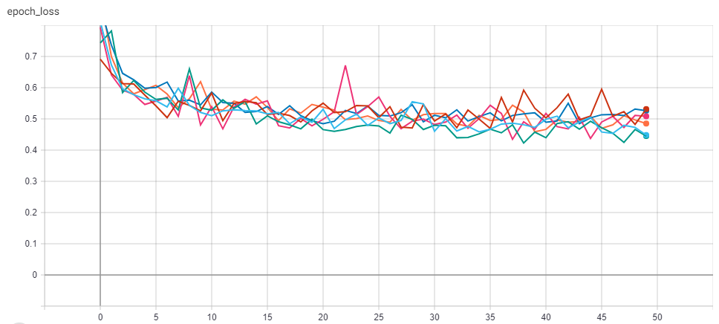
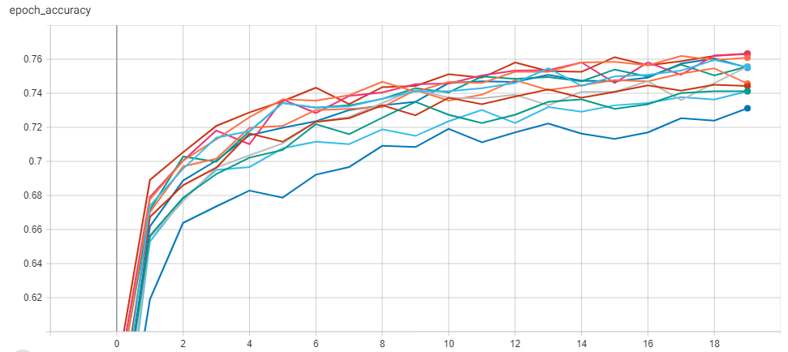
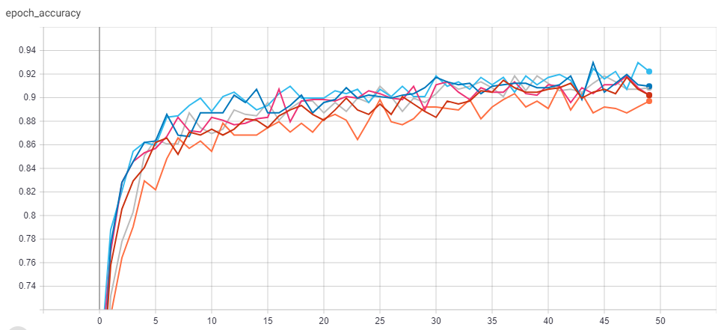
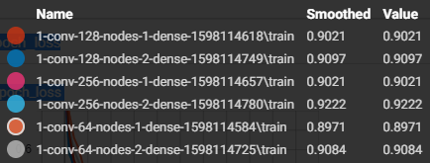
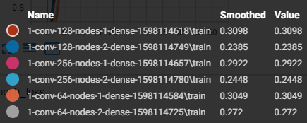
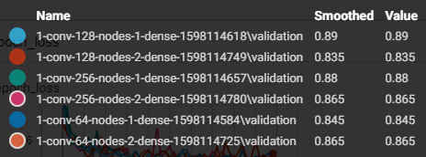
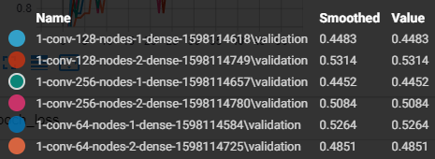
Data and Method
Model Training
CNN Model Building (Tensorflow Module)
Set the Hyper-parameter
Graph Accuracy
Graph Loss
Graph Val_Accuracy
Graph Val_Loss
p

Slide 18
Data and Method
Model Testing using Test Data
Doing the prediction process to Test Data
From the model that has been trained, this model will be used to make lithology predictions to the Test Data, namely Poseidon 2 data. The depth range used for prediction on Poseidon 2 is 4086-5297 meters. This depth range was chosen because at this depth it has complete Well-Log GR, RHOB, and NPHI data.

Slide 19
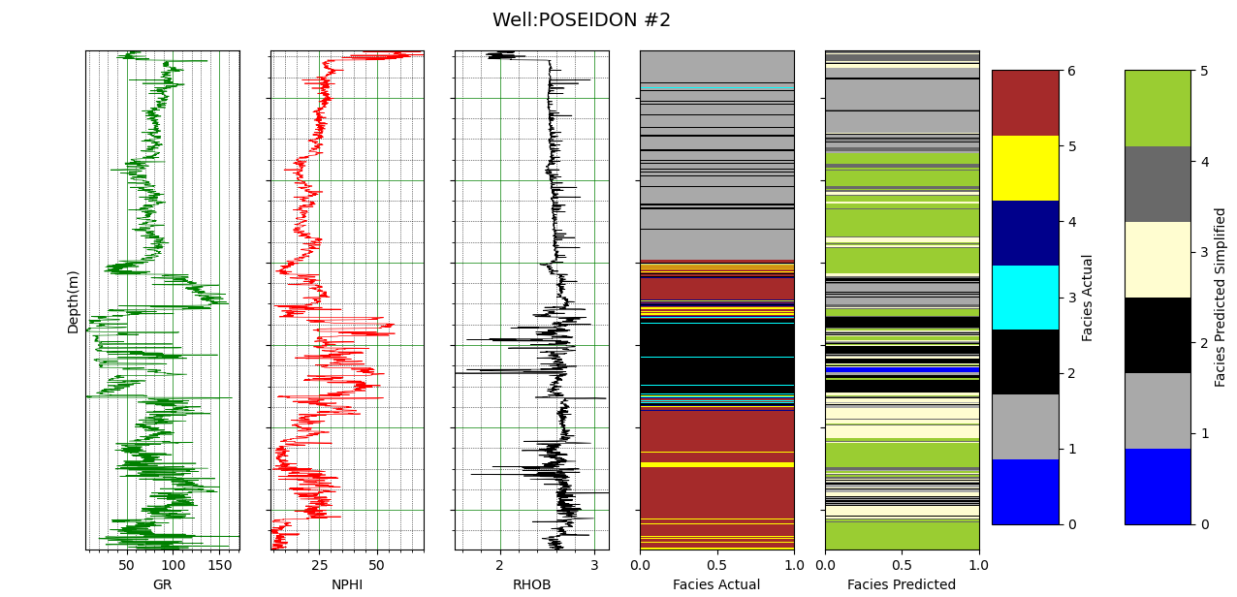
Result
Before Simplification
 | Actual | Predict
9 | - | S. Sandstone
8 | - | S. Claystone
7 | - | Ar. Siltstone
6 | Siltstone | -
5 | Sandstone | -
4 | Chert | -
3 | Calcarenite | -
2 | Volcanics | Volcanics
1 | Claystone | Claystone
0 | Calcilutite | Calcilutite
9
8
Accuracy =
30,21%
7

Slide 20
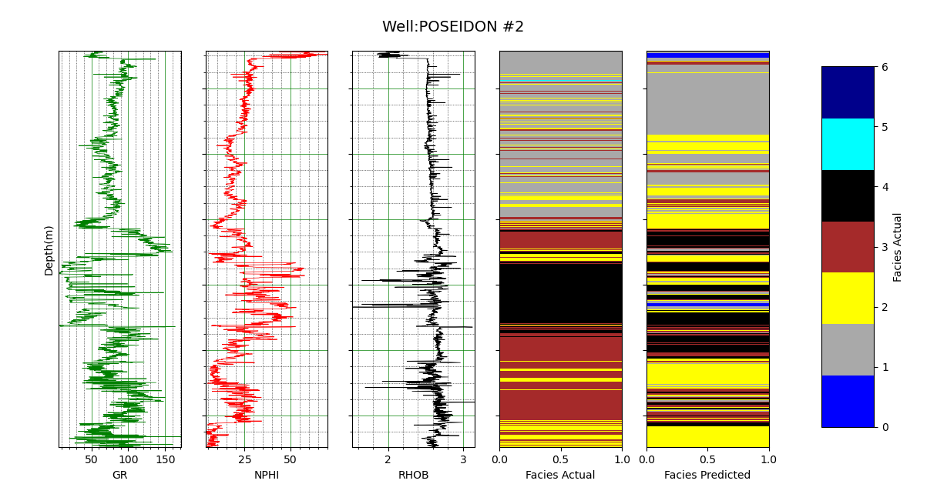
Result
After Simplifikasi
Chert
Calcarenite
Accuracy =
50,47%
Volcanics
Siltstone
Sandstone
Claystone
Calcilutite

Slide 21
Result
Approach
(Considering The Correlation between all logs and lithology)
GR Log Modification
Referring to the lithology classification of the value of Log Gamma Ray
API Level | Lithology
0 – 50 | Sandstone, Limestone, Dolomite
50 - 150 | Shale (Siltstone, Claystone)
> 150 | Organic-Rich Shale
Labeling :
For GR Value 0- 50 = 1
For GR Value 50-150 = 2
For GR Value > 150 = 3
Objective :
Simplified input, but still based on scientific data

Slide 22
Result
INPUT ADDITION
In the initial process, the input data used as a dataset only consists of 3 inputs, Gamma-Ray, NPHI Log and RHOB log.
Approach : Creating an Artificial Well Log with a Mathematical process
Logarithm
GR Log
NPHI Log
RHOB Log
12 INPUT
(First 3 Log + 9 additional)
1/Logarithm
Square Root

Slide 23
Result
FINAL APPROACH
Data Processing :
Input → 9 data
Simplification of Lithology Targets in Well Poseidon 1
Training and Test Data 10 times
The final result of the Lithology is the mode of 10 trials at each depth

Slide 24
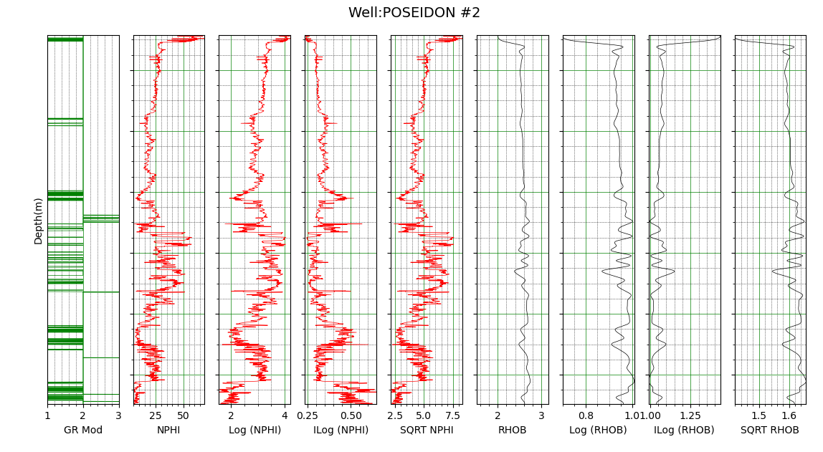
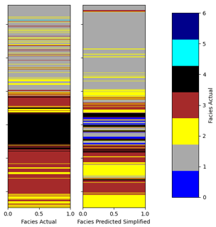
Result
Mode Results from 10 Training and Test Data
Chert
Calcarenite
Volcanics
Siltstone
Sandstone
Claystone
Calcilutite
Accuracy =
57,7%

Slide 25
Result
Thin Layer Analysis
(Drop Thin Layer From Dataset)
The dataset contains many thin layers that may be less detectable by the CNN model. Therefore, the process of removing thin layer inserts from the dataset is carried out to see how sensitive the CNN model is to thin layers. Thin layers are divided into several thickness variations:
< 5 meters
< 3 meters
The process is carried out by removing a thin layer on the test data

Slide 26
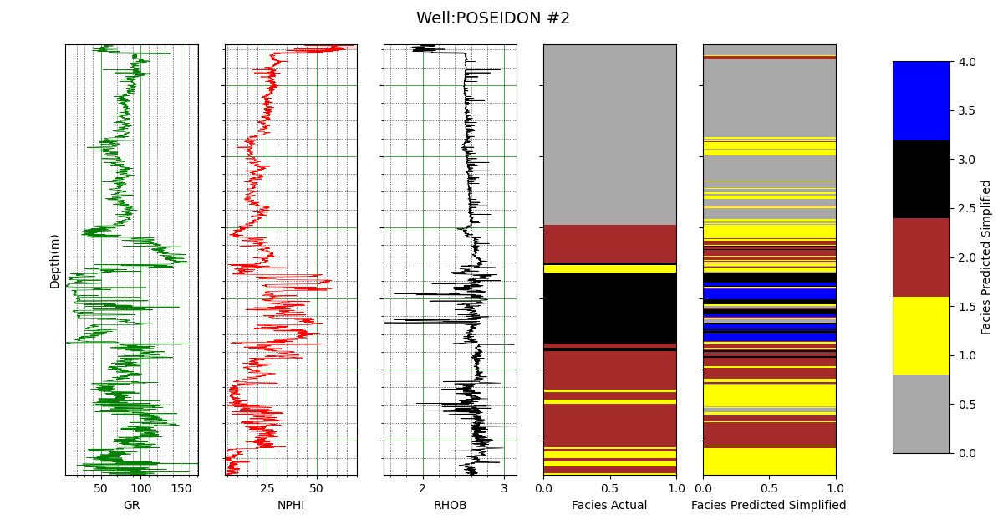
Result
Prediction Result
Thin layers <= 5 meters removed from Test Data only
Calcilutite
Volcanics
Accuracy =
61,58%
Siltstone
Sandstone
Claystone

Slide 27
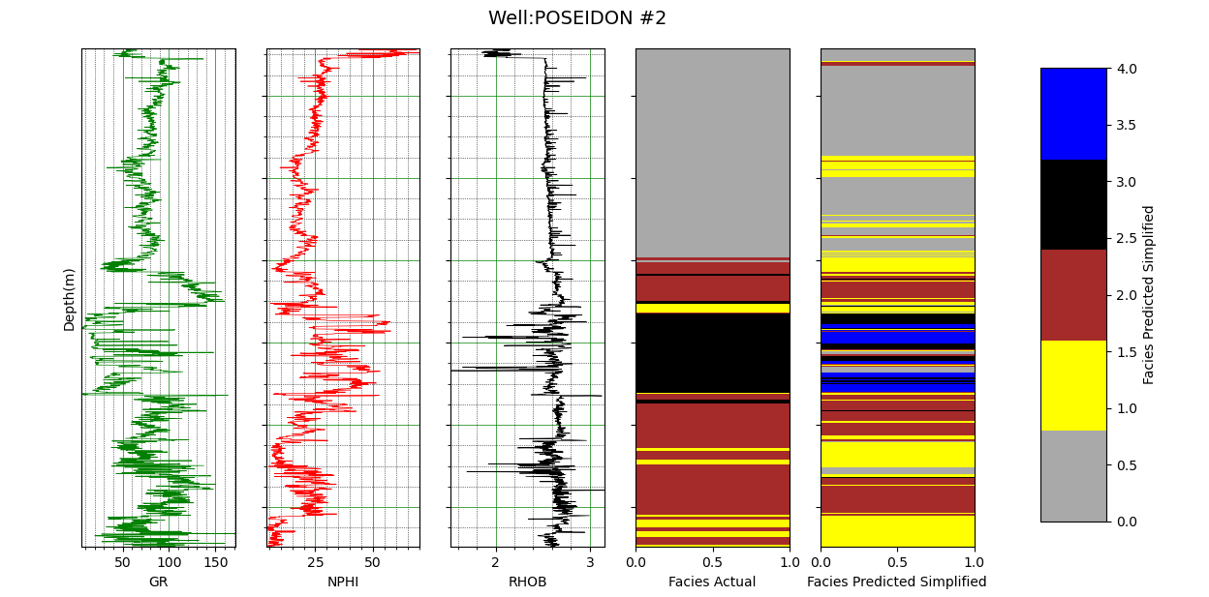
Result
Prediction Result
Thin layers <= 3 meters removed from Test Data only
Calcilutite
Volcanics
Accuracy =
63,43%
Siltstone
Sandstone
Claystone

Slide 28
Conclusion
The Lithology Prediction process in the Poseidon Field using the CNN Automation principle was successfully implemented with the best accuracy of 57.7%. Further research is still needed for CNN's ability to predict lithology in different depositional environments.
The CNN method can be used to classify lithology, but has not been able to automate the work process of Petrophysicists accurately, due to the limited amount of data, similarity of depositional environment, and rock parameters.
The model is less able to detect thin layer inserts that have a thickness of 3 meters (or less). This is could become a reference that the thin layers that may appear during the prediction, are less trusted for a thickness of 3 meters (or less).

Slide 29
Suggestion
The use of three well-logs (GR, RHOB, NPHI) is highly recommended in the CNN lithology prediction process, plus the development of artificial logging processes through mathematical processes, such as adding derivative data from each log.
Increase the number of nodes (above 256 nodes) at each layer in the CNN model

Slide 30
References
Hancock, N., n.d. Development Geology Reference Manual.
Imamverdiyev, Y. and Sukhostat, L., 2020. Lithological facies classification using deep Convolutional Neural
Network. Journal of Petroleum Science and Engineering, 174, pp.216-228.
Lapedes, A. and Farber, R., 1988. How Neural Net Works. American Institute of Physics,.
LeCun, Y., Leon, B., Yoshua, B. and Patrick, H., 1998. Gradient-Based Learning Applied to Document Recognition. PROC. OF THE IEEE,.
Liu, H. and Jiang, Z., 2020. [online] Available at: <https://www.researchgate.net/publication/251967990> [Accessed 14 August 2020].
Salsabila. 2018. Penerapan Deep Learning Menggunakan Convolutional Neural Network UNtuk Klasifikasi Citra Wayang Punakawan, Fakultas Matematika dan Ilmu Pengetahuan Alam, Universitas Islam Indonesia. Yogyakarta
Wang, Y., Li, Y., Song, Y. and Rong, X., 2020. The Influence of Activation in a Convolutional Neural Network Model of Facial Expression Recognition. applied science,.
Xu, B., Wang, N., Chen, T. and Li, M., 2015. Empirical Evaluation of Rectified Activations in Convolution Network.
Yu, J., Guo, K., Yuan, X., Fu, W. and Xun, Z., 2010. Wavelet Denoising of Well Logs and its Geological Performance. Energy Exploration & Exploitation, 28(2), pp.87-95.
2009 Poseidon 3D Marine Surface Seismic Survey Interpretation Report. ConocoPhillips (Browse Basin) Pty Ltd, 2012
2019. Regional Geology of The Browse Basin. Australian Government, Geosciece Australia.

